Slide 1
Lustre: Building a File System for 1,000-node Clusters
Mandumula Sai parthish.
1002022847.

Slide 2
Introduction
This paper is presented by Philip Schwan. Lustre is design in 1999, development began in earnest in early 2002.
Lustre is the open source distributed cluster file system is implemented with the goal of removing the bottlenecks traditionally found in such systems.
The major advantages of Lustre is efficient, scalable, and redundant.
The main ideology for the success of the luster is data , metadata and processors are kept separately and are connected by ethernet cable so that scalable is done when required.

Slide 3
Introduction
Lustre ’s internal networking has shown itself to be relatively flexible and high-performance, and network abstraction layers exist for TCP/IP.
Cache will reduce the load on primary OSTs for the most frequently accessed files, removing a very common bottleneck in distributed systems.

Slide 4
Distributed Lock Manager
Locks in the Lustre DLM are always managed by the service node, and do not change masters as other systems allow.
Omitting features of this type has allowed us to rapidly develop and stabilize the core functionality required by the file system.
File range locking is managed internally as part of the regular lock matching and compatibility functions. With the help of basic lock system , we can avoid the bottleneck operation for which a client must lock each page or block individually.

Slide 5
Object Protocols
The use of object protocols in the lustre by far the most pervasive.
By organizing the protocol around objects instead of blocks, the OSTs remain responsible for the internal metadata allocation.
OSTs are still responsible for managing the object locking and shared storage metadata, but clients can read and write individual data pages directly from the SAN.(storage area network)

Slide 6
Object Protocols
First, shared disk arrays on anything but the smallest clusters quickly become cost ineffective for even the largest customers; this would certainly violate our goal of running on inexpensive commodity hardware.
Second, high-level object protocols remove a key bottleneck for scaling beyond a dozen or two nodes: locking and allocation of metadata

Slide 7
Intents Gone Wrong
On requesting the object protocols from the servers there are high chances of intents going wrong or intents getting fail.
To get fixed in lustre there are two main procedures
One is to request for the entire object protocol again
Another is making parts of the data and request only for the missing part of the data.

Slide 8
Client Metadata Caching
When a node asks to lock a directory for reading or writing, if the directory has not recently seen conflicting activity. This allows the client to keep a cache which can be filled and selectively revalidated as necessary.
In the first mode, a client wanting to perform metadata operations will first take a lock on the parent directory, download the applicable directory information, and make many changes locally.

Slide 9
Client Metadata Caching
This is extremely efficient in times of low contention; it can perform as many operations as it wants locally without contacting the server, as long as no other nodes try to acquire the lock.
In the second mode, the client sends a message to the server for each operation, and the server performs the operation without giving any locks out.
When this mode is used, however, even directories with no contention have this behavior , and you suffer the effects of a server round-trip for each operation.

Slide 10


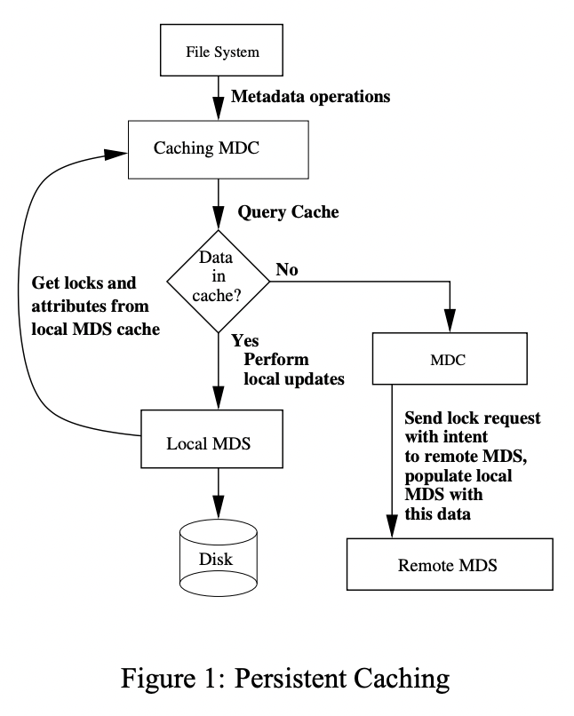
Persistent Caching
Luster's stackable object protocols allow a very symmetric design for the persistent cache by adding a metadata server to the client.
At some point, after a client has lost and reacquired a lock, we need a way to validate the data that already exists in the cache.

Slide 11
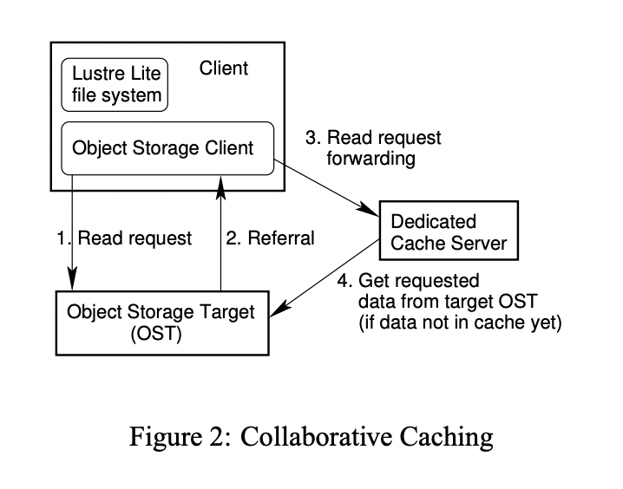
Collaborative Caching
If it is the first call it will not present in dedicated cache server so it hits directly to the Object Storage Target and get referral from the OST.

Slide 12
Collaborative Caching
When there is request from the client the request sends or forward it to dedicated cache server , if present then we get the cache server.
If it not there in the dedicated cache server then it get requested data from the target OST.

Slide 13
Conclusion
The lock manager and object protocols have served us well .
Today Lustre scales comfortably to more than 1,000 nodes and is running on 3 of the 8 largest clusters in the world[6] (at Lawrence Livermore and Pacific Northwest National Laboratories).

Slide 14
Thank you……
Lustre: Building a File System for 1,000-node Clusters

